Slide 1

Work Roles Session

Slide 2
Work Roles Facilitator Slide Deck – How to Use
How To Use This Slide Deck
This slide is intended for Facilitator’s use only and does not form part of the individual or group session.
This slide deck has been provided to enable facilitation of a Work Roles session. The session is designed to be 60-or 90-minutes long, depending on your group’s availability. It aims to help individuals understand what Work Roles are, the Work Roles Model and their report.
Before starting your session, please ensure that all those attending have completed the Professional or Focus Styles assessment and that they have access to a soft copy of their Work Roles Report. Please also ensure that you have shared the pre-session activity, which provides participants with background reading and a short exercise to complete before the session.
For those running a group session, ensure that you have also generated the Group Overview. Either use the group overview functionality live through the Oasys platform or insert the information you wish to share with the group into this slide deck. You can find the Work Roles Group Overview User Guide by accessing the following link: https://sccmsdata.blob.core.windows.net/media/Default/Mktg/WorkRolesGroupOverview.pdf

Slide 3
Work Roles Facilitator Slide Deck – How to Use
How To Use This Slide Deck
This slide is intended for Facilitator’s use only.
Content:
Ice Breakers
Introducing Work Roles
Understanding your work roles
Understanding your Group Work roles
Objective Setting

Slide 4

Introduction & Intentions
Being present
Confidentiality
Honesty & openness
Listening
Challenging Assumptions (nicely)
Looking to the future
Notes:
Increase self-awareness of strengths and challenge areas
Acknowledge the role they play in teams and learn more about team dynamics
Increase awareness of other people in teams
Fun group day with meaningful takeaways

Slide 5

Objectives
Better understanding: know our own styles, how we work together and feel safe
Learn more about our team dynamics and how we interact with each other
Pave our path forward and hold each other accountable
Notes:
Increase self-awareness of strengths and challenge areas
Acknowledge the role they play in teams and learn more about team dynamics
Increase awareness of other people in teams
Fun group day with meaningful takeaways

Slide 6

Our Selves
Notes:
Turn attention towards our own working styles – motives preferences, needs talents.
Before we do that, look at a model that helps us understand our self awareness

Slide 7
Self-awareness
The Johari Window
 | Known to Self | Not Known to Self
Known to Others | The Public Self | The Blind Self
Not Known to Others | The Private Self | The Unconscious Self
Public Self: These attributes or traits about a person which are known to that person as well as others
Blind Self: These are attributes or traits which are not known by the individual, but known to others
Private Self: These are attributes of traits which are known by the individual, but not by others
Unconscious Self: These are characteristics unknown to self as well as others
Notes:
Developed by Joseph Luft and Harry Ingham, this tool has two key ideas behind it:
Individuals can build trust by disclosing information about themselves
Individuals can learn about themselves with the help of feedback from others
Using the Johari Window, each person is represented by a four-pane window
Public self – known to self and others
Blind self – known to others but not you
Private self – known by you but not others
Unconscious self – unknown to both self and others
It represents a model of how we can understand who we are, how others see us and how we fit into the world.

Slide 8
Johari Window
 | Known to Self | Not Known to Self
Known to Others | The Public Self | The Blind Self
Not Known to Others | The Private Self | The Unconscious Self
Feedback
Shared discovery
Self disclosure
Notes:
As information is shared with other people, the boundary between the Public and Private Self moves downwards. And as other people reciprocate, trust tends to build between them.
As we receive feedback, the boundary between the public self and the blind self moves to the right – you learn more things about yourself that others can see but you didn’t know before.
Coming back to the two key ideas – the goal here is to increase the size of the Public Self quadrant
Explain how – two ways

Slide 9

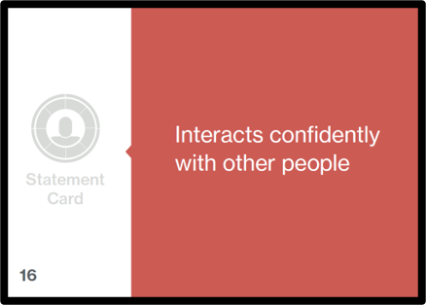
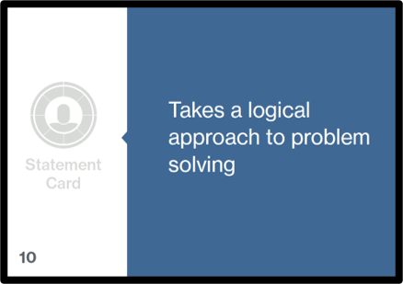
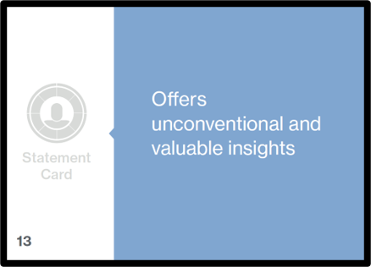
How I see myself
Aim is to collect 8-10 cards which describe you well
Keep the cards statement-side up
Try to avoid leaving unused cards on the table
Once you have selected your cards, return to your desk.
Notes:
Explain to the group that the aim is to collect eight-ten cards which they feel describe them well. Instruct the group to keep the cards “statement-side up” (this reveals which Work Role they are associated to and we do not want them to know this yet). Encourage the group to try to avoid leaving many unused cards on the table.
Explain that once everyone has selected their eight-ten cards they should return to their desks and place their cards in front of them – “statement-side up”. Collect in any remaining cards and keep them for discussion.
Discuss: How did they find the exercise? Easy? Difficult?
Does anyone have a lot of the same colour?
Does anyone have a spread of different colours?

Slide 10
How others see me
You will see various positively-worded statements laid out on the cards
The aim is to give cards to other people in the group who you think shows this behaviour at work
Once you have been given a card from someone else, you must keep this card​
You may receive more than one of the same card​
Notes:
Explain to the group that the aim is to give cards to other people in the group who they think shows this behaviour at work. Explain that once they have been given a card they must keep this card and they cannot give this card to someone else. Note that this may mean they receive more than one of the same card, which is fine.
Explain that once all the cards have been used up that they think are applicable to individuals in the group, they should lay the cards out that they’ve received ‘statement side’ up.
Discuss: How did they find the exercise? Easy? Difficult?
Does anyone have a lot of the same colour?
Does anyone have a spread of different colours?
Who gave who which cards? Happy to discuss why?
Explain that delegates now have the opportunity to give away any cards they feel don’t apply to them to others. Explain they don’t need to if they are happy with what they’ve been given.
Discuss which cards were given away and why. Do the group agree?

Slide 11








Cards Aligned to Work Roles
SUPPORTER
OPTIMIST
RELATOR
ASSERTOR
Understands the needs and feelings of other people
Typically remains composed in difficult circumstances
Communicates information
effectively to others
Gives clear direction to others
Typically effective at team working
Conveys confidence in themselves and others
Interacts confidently with other people
Is purposeful and confident in their decision-making
Establishes rapport with others easily
Tends to maintain a positive outlook
Makes a positive impression upon others
Tries to encourage and empower others
FINISHER
STRIVER
INNOVATOR
ANALYST
Is meticulous and checks things thoroughly
Pursues goals with enthusiasm
Provides original solutions
Skilled at evaluating various sources of information
Adheres to timescales and meets deadlines
Produces a lot of output
Offers unconventional and valuable insights
Takes a logical approach to problem solving
Keeps tasks moving and finishes of projects
Good at identifying and seizing opportunities
Likely to have a vision for the future
Inclined to explore all the available possibilities

Slide 12
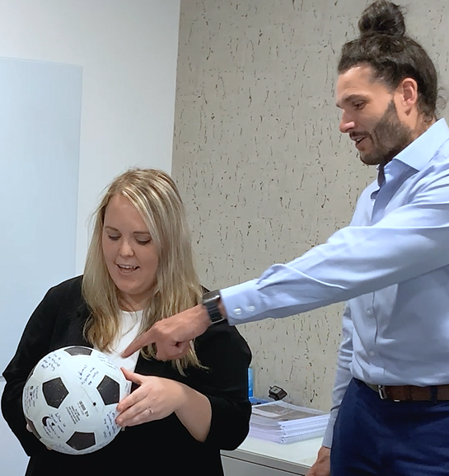
Coaching Ball
Notes:
Ask the group stand in a circle with empty space in the middle
Explain to the group this exercise is a fun energizer that will also help us all get to know each other better. The idea is very simple where I will start by throwing the ball to someone. That person will catch it and read out the question that is facing them. They must answer that question and then throw the ball to someone else in the group who hasn’t yet answered a question.
Make sure everyone has had a go at answering a question and then you can bring the exercise to a close. If it is a small group you may want to do a few rounds.

Slide 13

Making Connections
Useful activity to help us understand how we all work together?
It is a chance to show appreciation of our Strengths & Skills
Whilst taking part in this activity try to ‘Think about how it feels to receive this feedback’
Let’s have fun!
Notes:
Explain to the group this exercise is a fun energizer that will also help them to start to reflect on how they all work together. The idea with this exercise is someone will start by holding the ball of yarn/string and will identify someone in the group who they worked with that brought a strength/skill to that piece of work that they appreciated. Explain how you would like them to name the person in the group, explain what strength/skill they brought and why they appreciated it.
The person in the group who was mentioned must now walk to that person and take the ball of string/yarn while the other person holds the end. This will create a length of string/yarn going across the middle of the circle.
The person who has just collected the ball of string/yarn must now do the same mentioning someone else in the group who they worked with that brought a certain strength or skill they appreciated. They must hold on to the string/yarn from their position while again the newly mentioned group member walks over and collects the ball of string/yarn creating another length and connection across the circle.
This exercise should build humour as the more connections made the harder it is for members to get across the circle. Make sure everyone has had a go at answering a question and then you can bring the exercise to a close. If it is a small group, you may want to do a few rounds.

Slide 14
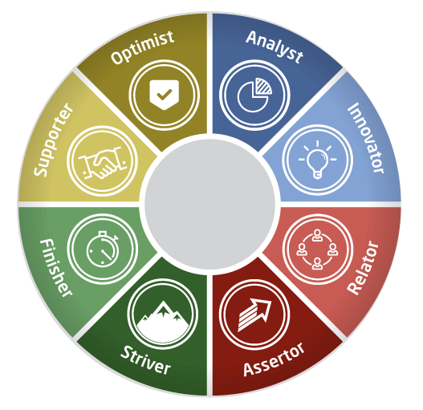
The Eight Work Roles
Notes:
Saville Assessment Work Roles model focused on providing insight into the different roles that individuals perform at work and is very useful for individual and team development. The more awareness we have about the type of roles we are likely to adopt in the workplace, the more we understand our impact as an individual and in a team. Within the model there are eight Work Roles.
Cards used represent the work roles model.
Mapped to Wave model already looked at – explain how (task vs people focused, clusters etc)
Allows us to learn about our preferred working styles and how we can work best with our team/other individuals

Slide 15


ANALYST
INNOVATOR
Analysts use their intellect and expertise to break down and evaluate information. They seek the right answer.
Innovators take a creative approach to problem solving and often develop
long-term strategies
Key Strengths
    Skilled at evaluating various sources of information
    Likely to take a logical approach to
    problem solving
    Typically inclined to explore all the
    available possibilities
Key Strengths
    Typically provide original solutions
    Tend to offer unconventional and valuable insights
    Are likely to have a vision for the future
Notes:
First up are Analysts. Analysts like to get the most out of the available information and use their expertise to break down information until they find the right answer.
<Pause between each one or take time to read the points given as key strengths on the slide. To increase group interaction, you could also ask by poll who has Analyst as their most preferred role.>
Innovators are creatives who love to come up with, and talk about, new ideas and different ways of doing things. They tend to look for things to change rather than stay the same.
Did anybody receive either of these cards?
Any reflections?
Does it resonate?

Slide 16


RELATOR
ASSERTOR
Relators actively communicate with others and can help improve the social interaction.
Assertors readily take control of situations and coordinate people well. They prefer to be the leader.
Key Strengths
    Typically communicate information effectively to others
    Tend to interact confidently with other
    people
    Are likely to make a positive impression upon others
Key Strengths
    Are likely to give clear direction to others
    Tend to be purposeful and confident in their decision-making
    Typically try to encourage and empower others
Notes:
Next up are the Relators who are extremely people oriented. Relators are able to quickly build strong relationships and communicate information clearly. They tend to impress others and can network effectively.
Assertors can lead the group effectively, encourage and inspire others to reach group goals. They make decisions easily and tend to stand by them.

Slide 17


OPTIMIST
SUPPORTER
Optimists tend to be resilient and can stay calm under pressure. They can help to keep morale high.
Supporters attend to the needs of others and prefer a team-oriented approach.
Key Strengths
    Typically remain composed in difficult circumstances
    Are likely to convey confidence in themselves and others
    Tend to maintain a positive outlook
Key Strengths
    Are likely to understand the needs
    and feelings of other people
    Are typically effective at team working
    Tend to establish rapport with others easily
Notes:
Optimists stay calm in stressful situations and normally appear confident. They are good at keeping overall group morale high due to their optimistic and positive outlook.
The Supporter is a real team player who understands the motivation of the rest of the team and will encourage everyone to make contributions. Supporters put people at ease and are good at showing empathy.

Slide 18


FINISHER
STRIVER
Finishers focus on getting things completed to a high standard and pay attention to detail. They tend to be meticulous and check things thoroughly.
Strivers push hard to achieve ambitious results. They are often highly enterprising and competitive.
Key Strengths
    Tend to be meticulous and check things thoroughly
    Typically adhere to timescales and meet deadlines
    Are likely to keep tasks moving and finish off projects
Key Strengths
    Are likely to pursue goals with enthusiasm
    Tend to produce a lot of output
    Are typically good at identifying and
    seizing opportunities
Notes:
And finally our last two Work Roles, the Finisher and the Striver.
Finishers are very detail-oriented. They produce high quality work and will keep tasks moving to meet deadlines. They take action to make things happen.
Strivers tend to be driven; they pursue goals with determination, even when there is a difficult challenge. They work quickly and tend to identify new opportunities.

Slide 19

Understanding your Work Roles

Slide 20


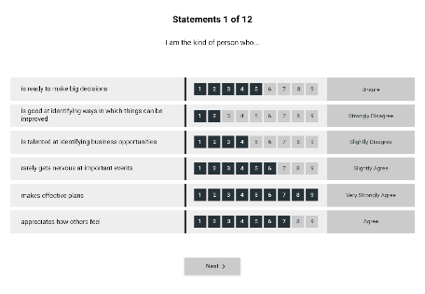
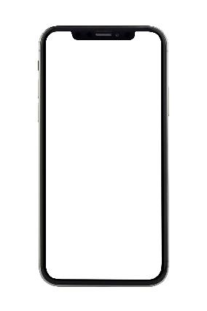
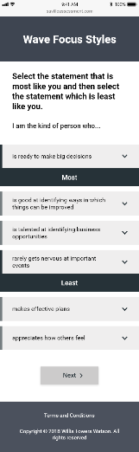

You completed Wave Focus Styles…
Notes:
Experience completing?
How did you find the ra-ra?
You’re not just one thing….
Can go through fairly quickly

Slide 21

Your responses were compared with a group of over 5,000 Professionals & Managers in the UK
Notes:
Discuss the benchmark group:
To give meaning behind the data, responses are compared against a benchmark group.
It’s not only someone’s self rating, but how typical that rating is when compared to a broad peer group. Are they similar to most others? Do they have less of an inclination or more of an inclination for a given area than others in that group?
This group has been selected because it reflects the diversity of the candidates from a wide range of jobs with different companies, industries and regions.

Slide 22

The ‘Sten’ Scale
1
2
3
4
5
6
7
8
9
10
Less Likely
As Likely
More Likely
Notes:
Profiles are scored using a benchmark to give them meaning. Where an individual scores a seven and above, their responses to the questionnaire suggest they are more likely to adopt that Work Role than others.
Where an individual scores a four and below, their responses to the questionnaire suggest that they are less likely to adopt this Work Role.
Scores of five and six are considered average when compared with the benchmark group.
This can be plotted on a normal distribution graph: with most people falling somewhere in the middle.

Slide 23

Report Output:
Focus Styles Work Roles
Notes:
The Work Roles Report provides an indication of the types of roles that an You are more or less likely to adopt in the
workplace. It also explores the likely impact of these preferred and less preferred roles when working and interacting with
others.
The Work Roles Report provides an individual with a Work Roles profile and accompanying advice, based on their
completion of a Wave assessment. The report provides information on an individual’s most and least preferred roles, how
these roles might play out in combination, how an individual might make the most of their own work roles and what they
might need to consider when working with others who are similar to or different from themselves

Slide 24
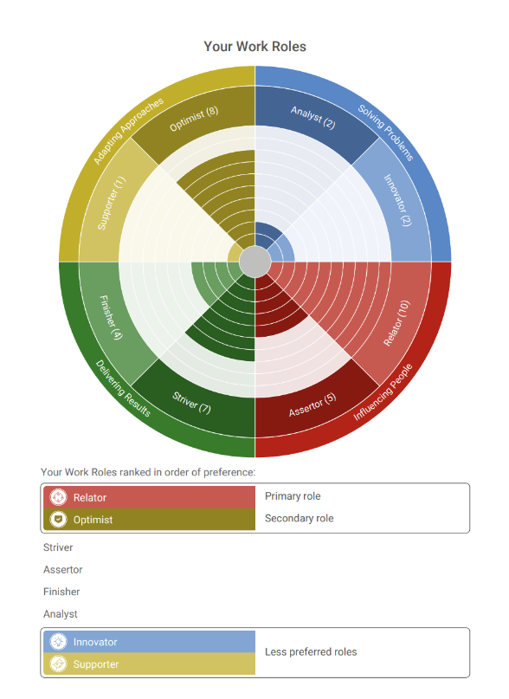
Your Work Roles
(Page 4)
The eight different Work Roles are presented on a wheel. Scores are presented in brackets after the Work Role
The second half of the page rank-orders the eight Work Roles, with the most preferred Work Role at the top and the least preferred at the bottom

Slide 25
How to get the best from me
My most / second most preferred Work Role:
My least / second least preferred Work Role:
Two suggestions for getting the best from me:
Where it has helped me…
Where it might potentially hinder me…
Where it might potentially hinder me…
Where it has helped me…
E.g. “I find it really helpful when…”
Notes:
Last exercise looked at decreasing blind self-quadrant, now going to look at decreasing the private self quadrant.
Sharing some of private self, share what comfortable. Just share the one you’re most comfortable to share. Very helpful for team building.
Time to think about three things on screen (5ish mins)
Two suggestions for getting the best from me (me to give an example)
Share with the group – suggest people take notes on others suggestions
Most – everyone. Sometimes strength areas can become overplayed strengths.
Least – everyone
Two suggestions

Slide 26
Point of View
Consider the following scenario (delete as appropriate):
You are given a project with an impossible deadline
A customer who changes their mind constantly
Providing constructive/negative feedback to a team member you are close to
People feel afraid to ‘speak up’ within the organisation
You need to push back on a decision you believe is wrong
How might your work role react to this difficult situation?
Discuss
What might be your initial reaction to the situation/problem?
Have you faced this situation before?
How might you prefer to react instead?
Notes:
Ask the delegates to go and sit by their most preferred Work Role and form smaller working groups.
Choose a difficult situation at work – how might the delegate’s work role react? Choose a relevant scenario (feel free to amend or add these) and read out to the group:

Slide 27

Coaching Conversions
10 minutes for each person
Chance to have coaching and be coached in your work roles
Find a partner and discuss:
How your most and least work role play out positively in your role e.g. how it has helped you to achieve success.
How your most and least work role has played out less positively e.g. hold you back in your role.
Useful prompts to consider:
  What are you doing too much of?
  What are you doing too little of?
  What other styles might be useful to incorporate into your role?
  How might you bring in that alternative style into your work?
Notes:
Delegates are put into pairs. Ask them to re-read their most and least preferred work roles.
Delegate 1 speaks about how their most and least work roles play out positively in their role e.g. how they have helped them achieve success.
They then discuss when their most and least work roles have played out less positively. E.g. held them back in their role.

Slide 28
Communication Challenge
10 minutes for each person
How our work roles influences communication
In your groups, choose what to send to Alex.
Alex is the key decision maker for purchasing new IT resources for their firm.
Important to consider the work role of Alex and communicate in a style that they will appreciate.
There are your options of what to include:
  Document containing the full scope of the project
  Flyer with an invite to provide customer feedback on the IT resource
  Biographies of Tech Pulse’s CEO and COO
  Link to ‘Meet the team’ at Tech Pulse
  Key benefits document on the IT resource
  Implementation dates available if milestones are achieved
Notes:
Decide on how to break the group into eight separate groups (suitable for larger groups) or into four separate groups (suitable for smaller groups) based on the four clusters of the Wave Model.
Ask the delegates to sit within their group
Read the following scenario out loud to the group:
You work in the sales team at Tech Pulse who are responsible for selling new IT resources within companies. You have recently met with Brian who is the key stakeholder for making IT decisions. We require you to work in your team to write up an example email to ‘Brian’. The goal of this communication is to provide an appropriate amount of information to summarise.
Explain that the group has 10 minutes to complete the exercise and at the end they will require a spokesperson to feedback their answer.
Facilitator to go around to each group and give them a different work role or work role cluster (depending on delegate size) for ‘Brian’
Discuss
How did they find the challenge?
Did they notice that each group had Brian with a different work role?
Was there anything they found particularly hard with this challenge?

Slide 29
Which Work Role will survive on the moon?
You are a member of a space crew originally scheduled to rendezvous with a mother ship on the lighted surface of the moon. However, due to mechanical difficulties, your ship was forced to land at a spot 200 miles from the rendezvous point. During re-entry and landing, much of the equipment aboard was damaged and, since survival depends on reaching the mother ship, the most critical items available must be chosen for the 200-mile trip.
Your task is to rank order the items in terms of their importance for your crew in allowing them to reach the rendezvous point. Place the number 1 by the most important item, 2 by the second most important, and so on through to number 15 for the least important.
Notes:
Delegates should break into smaller working groups (either based on their 8 most preferred Work Roles or the 4 Clusters of the Wave Model).
The facilitator (you) will read through the following scenario:
Could a facilitator join a group if only one person?
The groups will have 10-15 minutes to assign ranks to the items.
The facilitator (you) will then read through the correct answers and determine the winner.

Slide 30




Dual Roles
Notes:
If you now look at page 5, you will see your Dual Role.
This is the combination of your top two most preferred roles.
Exercise
Can you take a couple of minutes to think of an example when your dual role has helped you to be effective in the workplace?
<Allow the group to take some time to open the report and consider the question. Dependent on group size, you may wish to have the group simply write down their responses or share verbally with the group>

Slide 31








A Day in the Life
Analyst
Innovator
Assertor
Choose one of your preferred Work Roles
Think of an example where this style has led to:
  A positive outcome
  A less positive outcome
Sharing with the group
Relator
Optimist
Supporter
Striver
Finisher
Notes:
Sharing some of private self, share what comfortable. Just share the one you’re most comfortable to share. Very helpful for team building.

Slide 32
Role Contrasts
Find a partner and discuss:
  - Your preferred Work Roles
  - How could your styles work most effectively together?
  e.g. Could a Finisher help an Innovator to think about the desired outcome of their idea?
Aim to speak to 2 people
Try to speak to people with different preferences from yourself
You can use pages 8-9 of your report to help you.

Slide 33

Understanding Teams

Slide 34
Team Theory
How Groups Bond (Tuckman)
Performing
Working as one
Norming
Working with each other
Performance
Storming
Challenging each other
Forming
Starting to learn about others
Notes:
Stages a team goes through – Bruce Tuckman from 1960s.
Forming – lots of focus on the leader here, maybe more focus on past experiences.
Storming – maybe challenging themselves as well as others, feelings of inadequacy. Danger of being distracted from the project.
Norming - If the Norming stage can be reached, it is an exciting time for all, when big decisions can be made and implemented, new ideas turned into reality, risks taken and failure seen as simply another step along the pathway to success.
Performing - The team is now a powerful engine running with all its cogs turning. Plenty of healthy conflict, of the type that does not damage the fabric of the relationships, is interspersed with fun and humour.
Write it down – where you think you are? Hand raise
Changes every time someone leaves or joins.
Hopefully should get quicker.
Learn about the new people, everybody interacts with them, how it effects those who were already in the team.

Slide 35
Team Theory
Diversity of thought in teams (Klein)
Teams with many different roles
Performance
Teams with the same roles
Time
Notes:
Diversity of thought having different ideas, make the most of everyone in the team at performing stage, harness all of their ideas.
How do they see their team in terms of diversity?

Slide 36
Work Roles Important to Our Team
SUPPORTER
OPTIMIST
RELATOR
ASSERTOR
Understands the needs and feelings of other people
Typically remains composed in difficult circumstances
Communicates information
effectively to others
Gives clear direction to others
Typically effective at team working
Conveys confidence in themselves and others
Interacts confidently with other people
Is purposeful and confident in their decision-making
Establishes rapport with others easily
Tends to maintain a positive outlook
Makes a positive impression upon others
Tries to encourage and empower others
FINISHER
STRIVER
INNOVATOR
ANALYST
Is meticulous and checks things thoroughly
Pursues goals with enthusiasm
Provides original solutions
Skilled at evaluating various sources of information
Adheres to timescales and meets deadlines
Produces a lot of output
Offers unconventional and valuable insights
Takes a logical approach to problem solving
Keeps tasks moving and finishes of projects
Good at identifying and seizing opportunities
Likely to have a vision for the future
Inclined to explore all the available possibilities
Notes:
Select which cards are important for the team

Slide 37
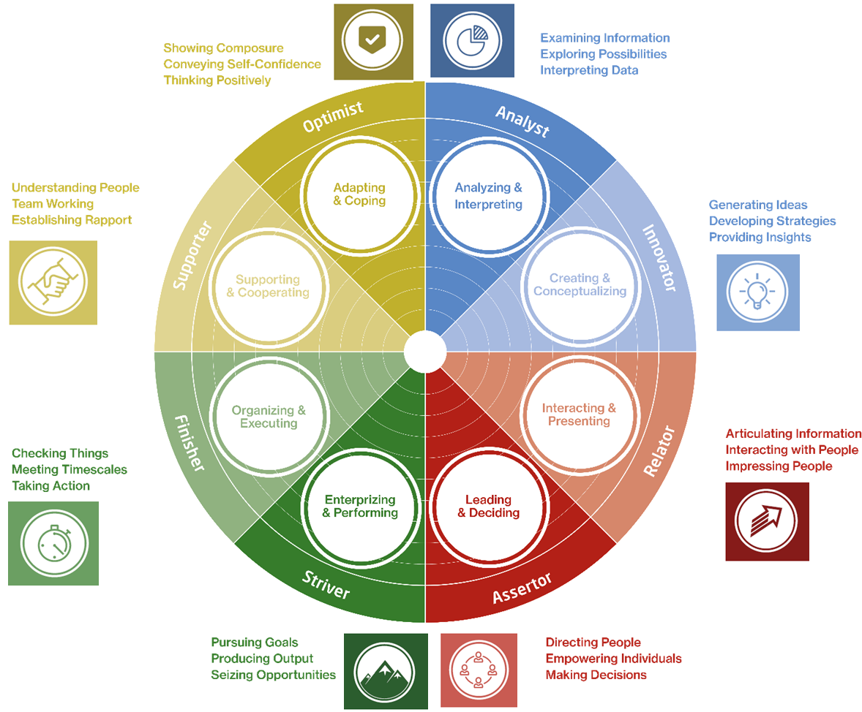
Our Group Profile
Predictions
Notes:
Recap of the roles
Can link back to cards from earlier

Slide 38
Group Point of View
In your group, decide on a work role for either a most or least preferred style
Consider the following scenario (delete as appropriate):
You are given a project with an impossible deadline
A customer who changes their mind constantly
Providing constructive/negative feedback to a team member you are close to
People feel afraid to ‘speak up’ within the organisation
You need to push back on a decision you believe is wrong
How might different work roles react to this difficult situation?
Discuss
What might be their initial reaction to the situation/problem?
What might they do well?
What might they do less effectively?
What might they need to move forward? (think about what behaviours they need to utilise e.g. what work roles within the team might be useful to use)
Notes:
Delegates are split into smaller groups and randomly choose any a work roles to indicate a either a most preferred or least preferred style. E.g. striver or optimist
Delegates are split into smaller groups and randomly choose any a work roles to indicate a either a most preferred or least preferred style. E.g. striver or optimist
Choose a difficult situation at work….
Discuss
What key steps have been learnt from completing this exercise
Can delegates think of any specific difficult situations they can apply this to?

Slide 39

Ready, Steady, Change
Work Roles supporting the team to adapt to change
Let’s agree on a project or goal for the year.
As a group, work together to identify the statement cards which reflect the behaviours required to implement the new task effectively as a team.
Once you have identified them, rank these in order of importance.
Then turn over the work role to reveal the Work Role they are aligned to.
Notes:
The facilitator (you) should take a card deck and lay out the ‘statement cards’ (9-32) on the desk so that the whole group can see the cards.
As a group, delegates should work together to identify the statement cards which reflect the behaviours required to implement the new task effectively as a team. Once they have identified the behaviours, they should try to rank these in order of importance.
Once the group has done this, they should turn over the statement cards to reveal which Work Role they are aligned to.
You will then reveal the Group Overview so that the group can consider the similarities and differences between their own profile and what they identified as a group as being important.

Slide 40
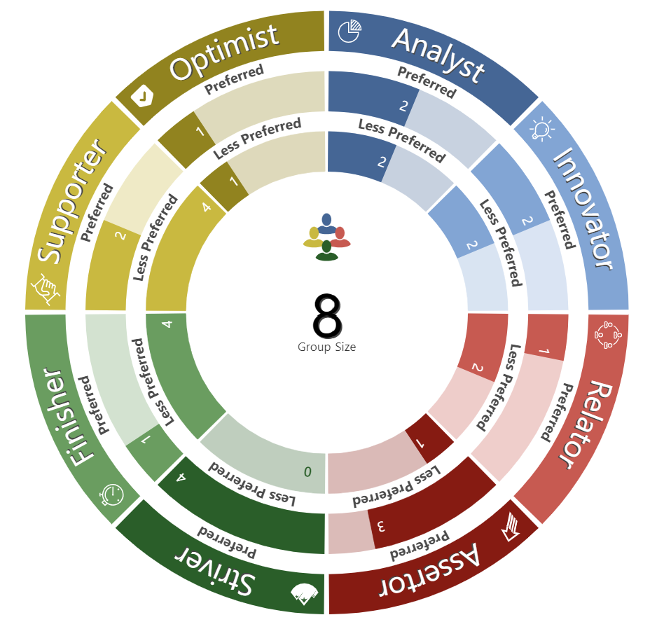
Mind the Gap
Everything this group delivers is through leading matrix teams, rather than direct reports.
Given your group wheel:
What challenges might this group face in this task?
How might you leverage your preferred roles and styles to help you navigate these challenges together?
What role ‘gaps’ within your group might you need to be aware of?
Notes:
Split into 2 groups
Collaboration key
Have a group discussion and begin to think about how the group can be mindful of the missing Work Roles. How might they go about addressing these ‘gaps’ going forward?
explain to the group that an area where there is no one with this as their most preferred role doesn’t necessarily mean that it is a ‘gap’. It should only be determined a ‘gap’ if they feel that the addition of this role would be beneficial.

Slide 41
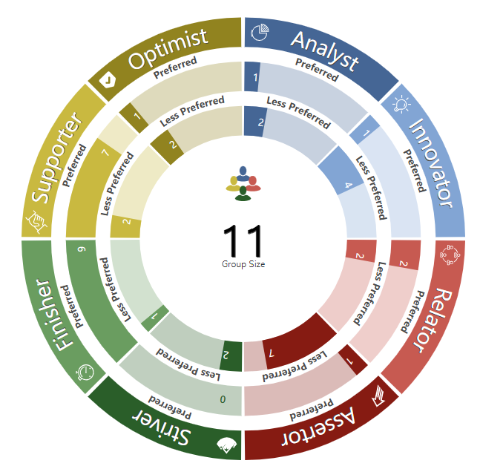
How do we grow together as a team
SWOT Analysis
In two groups, consider:
What are the strengths of the group?
What are some potential weaknesses?
When looking at your strengths, what kind of opportunities might there be for you to become more effective?
When looking at your weaknesses, what kind of threats might they pose to your group?
Notes:
Break out into groups x 2
Are there particular projects at the moment where you see potential for the opportunities identified?
What do you need to do to prevent the threats?

Slide 42
SWOT Analysis
Strengths | Opportunities
Weaknesses | Threats
Notes:
Come back and discuss as a group
Populate during conversations
How does this look? Any language that we want to adjust

Slide 43
Stop Start Continue
Write down on post-its, for you as an individual:
1 thing you will STOP doing
1 thing you will START doing
1 thing you will CONTINUE doing
STOP
START
CONTINUE
Taking on too much, not delegating enough
Asking for feedback more frequently e.g. at least once per week
Supporting others to solve complex problems
Notes:
This is to help us reflect on what our takeaways are from today
Take 3 post-its each. Using your development plan to help you – take some post-its and on each one write a single thing you will start doing
We’re aiming to have 3 post-its each, that we can all stick up onto the wall when we’re done under stop start and continue.
Discuss reflections and takeaways as a group.
** Individual first – flipchart. Next -> As a team. Reflect back on individual reflections

Slide 44
Stop, Start, Continue as a group
Stop | Start | Continue

Slide 45
Next Steps
‘Teams that periodically reflect on how they are doing are more likely to benefit from shared thinking, information-sharing and collective memory’ - CIPD May 2023
Who will take accountability for taking these actions forward?
When will you next check in?
How often are you going to revisit this?

Slide 46
WOOP Approach to Goals
Rethinking Positive Thinking – Gabriele Oettingen
Outcome
Obstacle
Plan
What is an important goal you want to achieve? Your wish should be both challenging but realistic
What will be the best result from achieving your wish? Think about how you want to think, feel and be. Vividly describe the outcome.
What is the main obstacle that might prevent you achieving your wish? Vividly describe the obstacle
What is an effective action or actions to overcome the obstacle? Make an if-then plan, i.e. if x happened, then we will do y.
Wish
‘The obstacles that we think most impede us from fulfilling our wishes can help us to realize them.’
Notes:
Used for behavioural change – scientific name of Mental Contrasting with Implementation Intentions (MCII)

Slide 47
WOOP Activity
Science-Based Mental Strategy
Write down a goal that you Wish to achieve.
  Pick an established goal for the group and identify a specific Wish within this and establish what the goal means to you personally. The wish should be challenging but one that can be fulfilled realistically. Please be as descriptive in the detail as possible.
What will be the best Outcome from achieving your wish?
  Think about how you want to think, feel and be. Vividly describe the outcome.
What is the main Obstacle that might prevent you achieving your wish?
  Vividly describe the obstacle
What is an effective action or actions to overcome the obstacle? Make an if-then Plan.
  i.e. if x happened, then we will do y.

Slide 48
GROWS Objective Setting
As a group, let us decide on an objective/goal we would like to achieve:
Goal
Reality
Options
Will
Support
1: Articulate your Goal
  Write your goal in 1 sentence
2: Reality – What are the facts?
  How close are you to that goal?
3: Options – Write down all your ideas.
  What are all the ideas to help? Brainstorm all the options
4: Will – What will you do?
  What action will you take? What would it take to get your will behind the options you have selected?
5: Support – who can you enrol to help you?
  Who is going to help you? Who is on your side?

Slide 49
Notes:
What’s gonna be your main personal takeaway?
Thank you.
Talk about next steps and close the day.

